Slide 1
Decentralized Federated Learning Ranked Signals

Slide 2
2023-2024

Slide 3
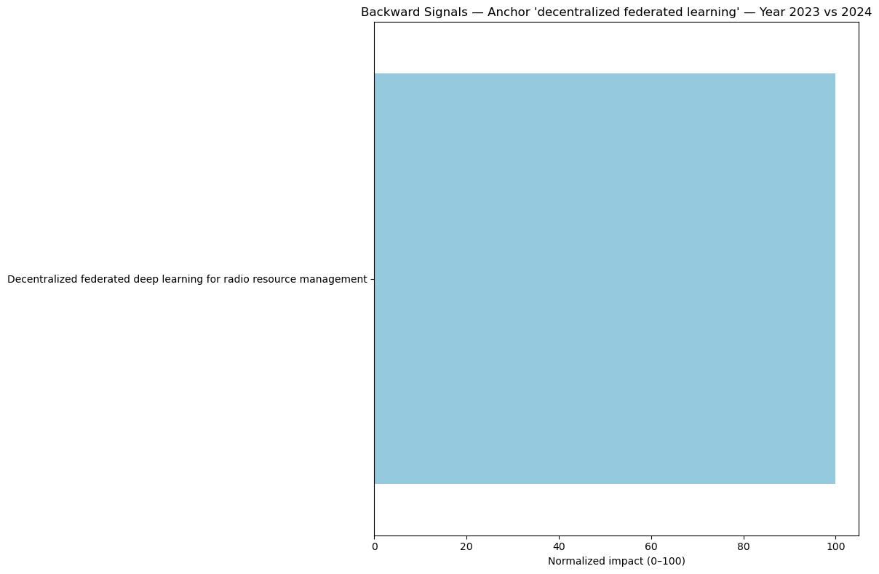

Slide 4
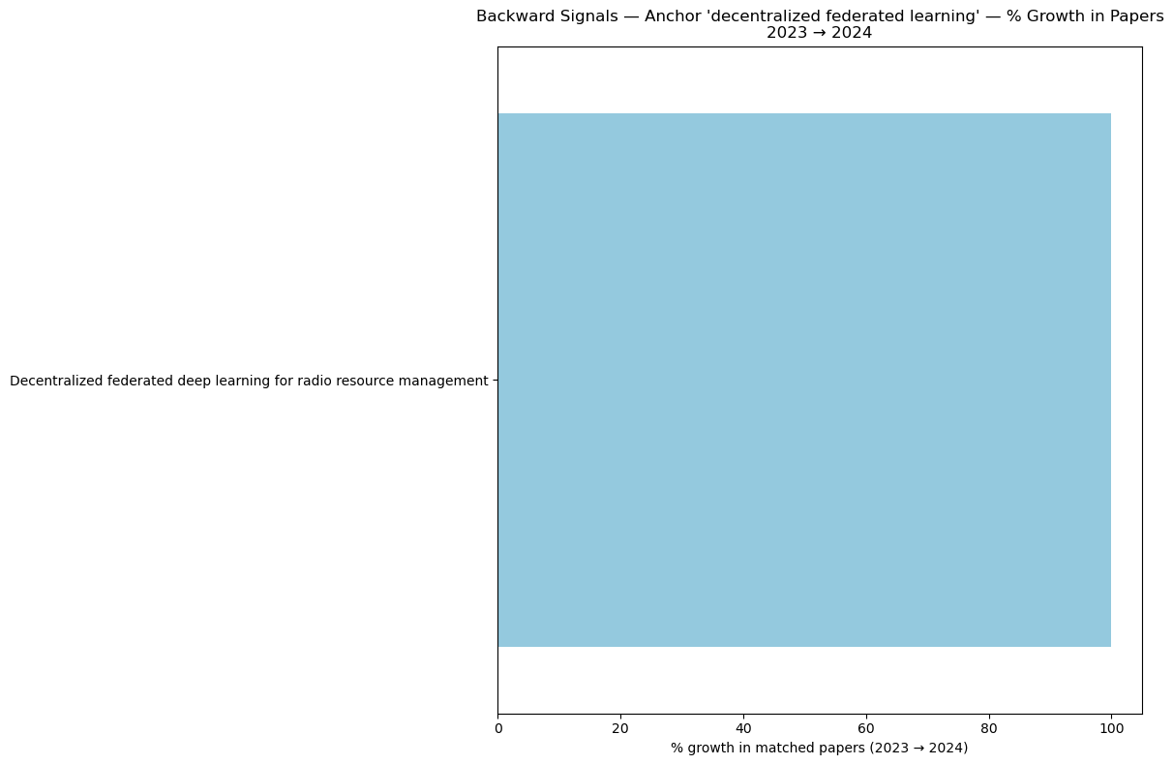

Slide 5
2022-2024

Slide 6
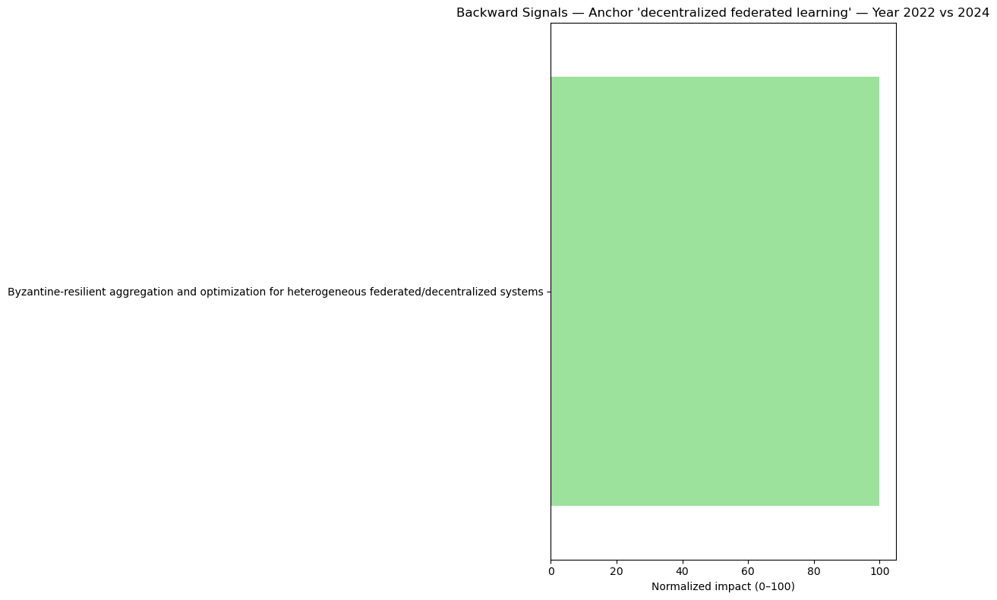

Slide 7
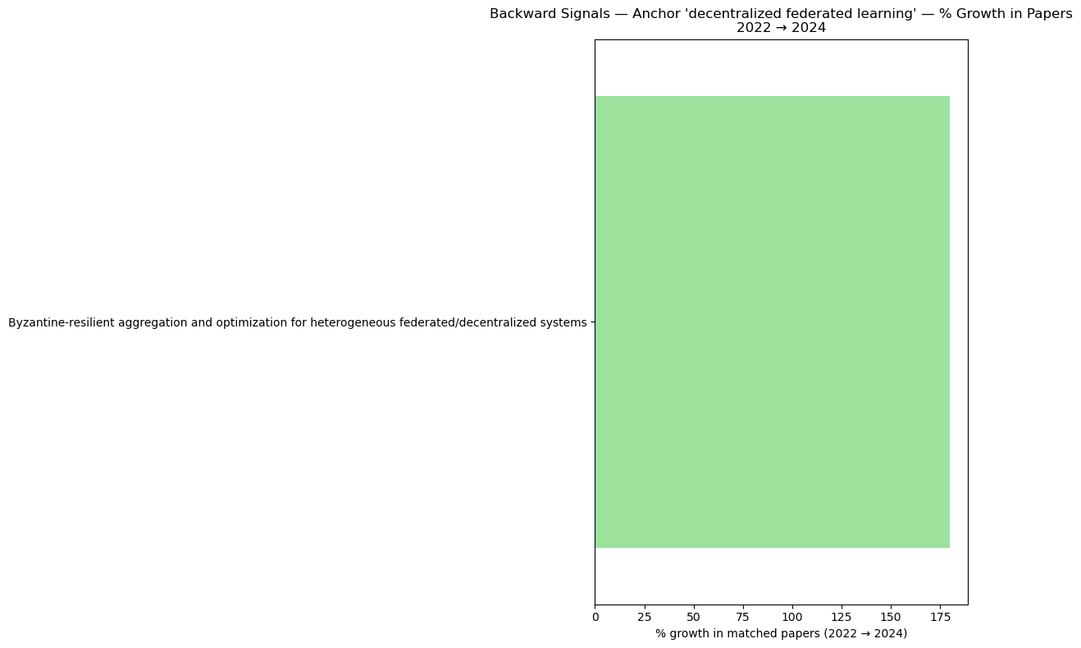

Slide 8
2020-2024

Slide 9
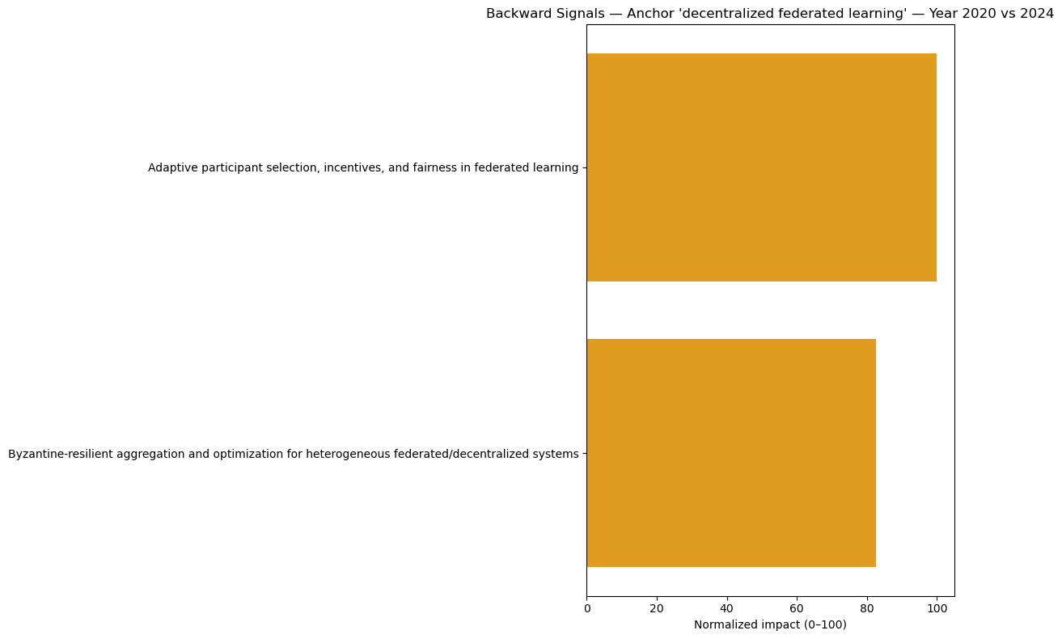

Slide 10
